Slide 1
/dataset/zhongqiaoyong/MedicalImages/mri/npy/imgs/Mri_acdc_patient088_frame02_slice_14.npy
ACDC | 0.376 | 0.262
STARE |  | 0.140

Slide 2
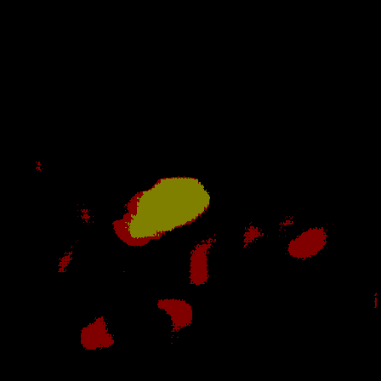
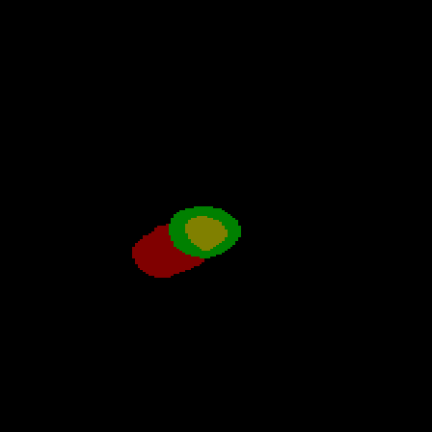

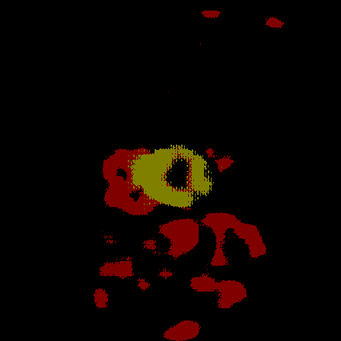
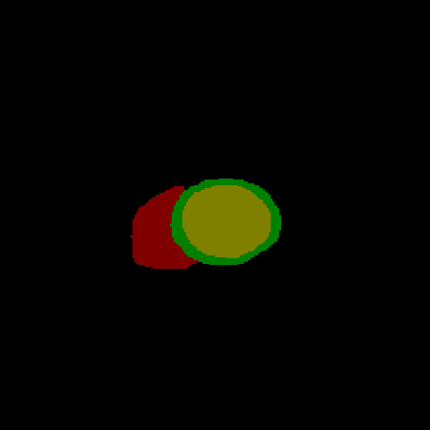
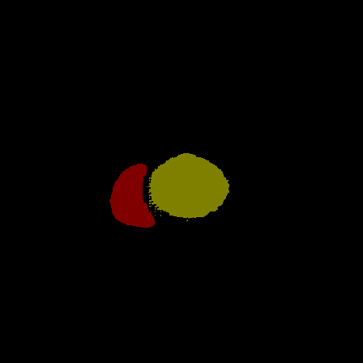
With lora
GT
w/o lora

Slide 3
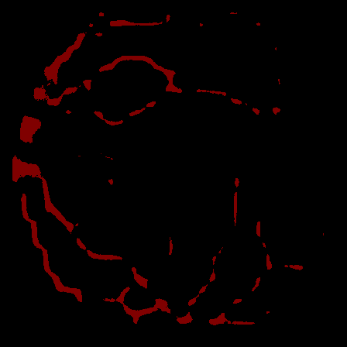
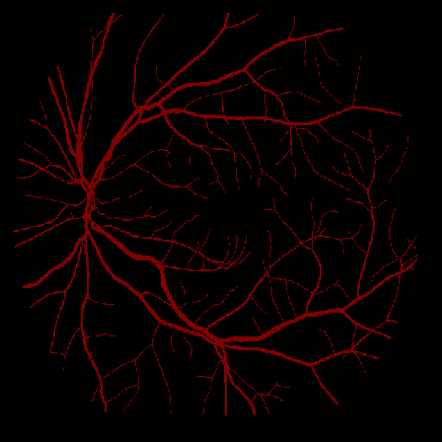
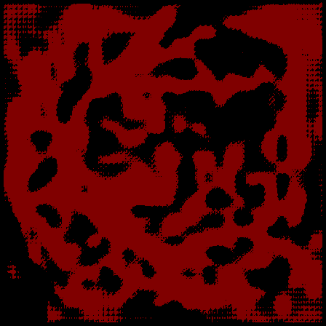
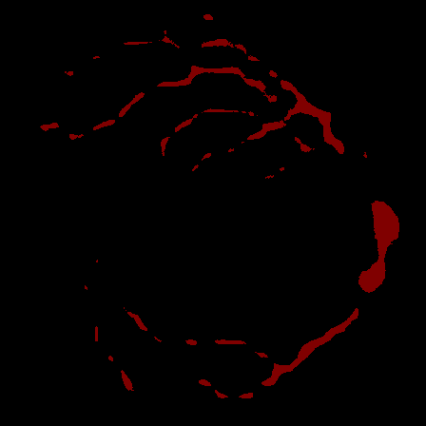
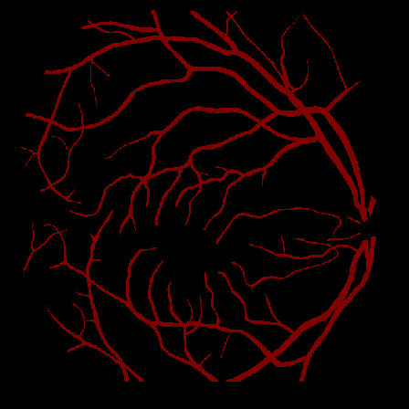
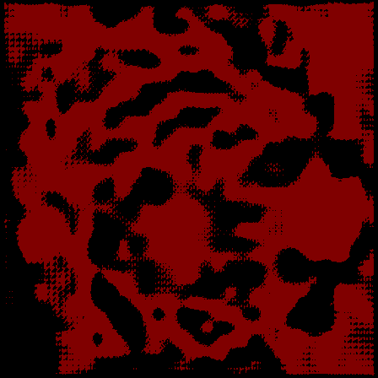
W/o lora
GT
With lora

Slide 4
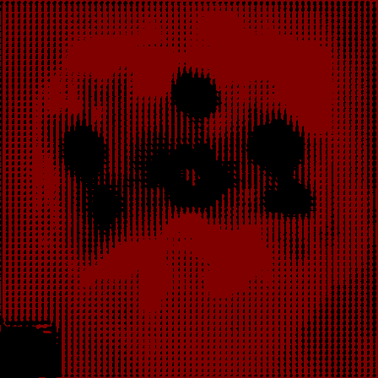


Slide 5
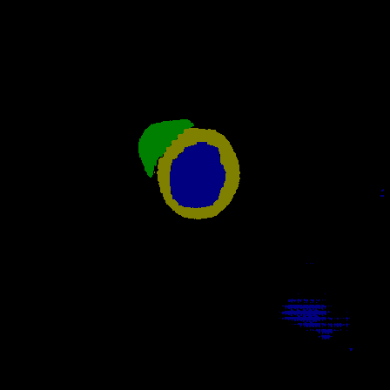
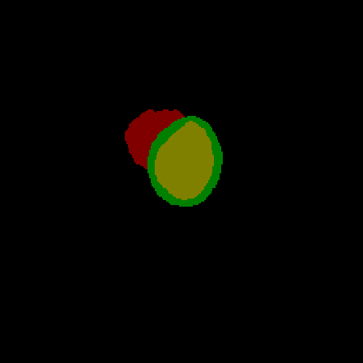




Slide 6
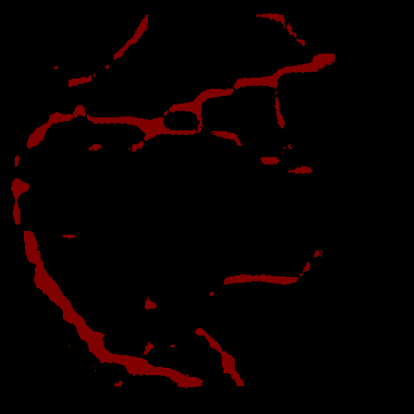
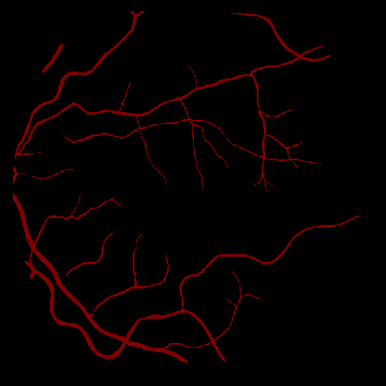
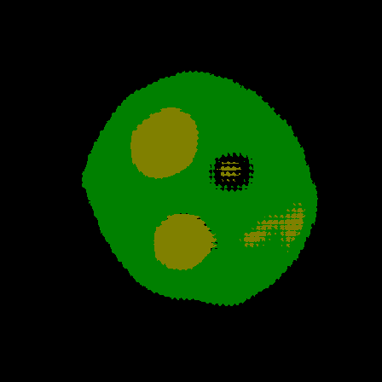
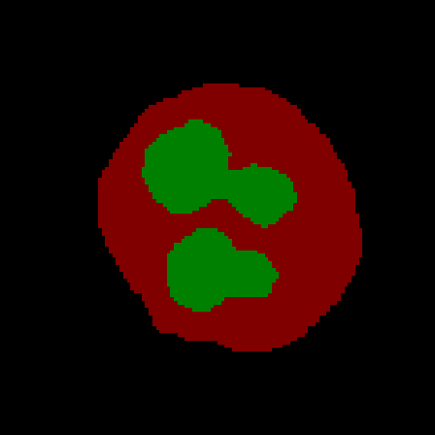

Slide 7
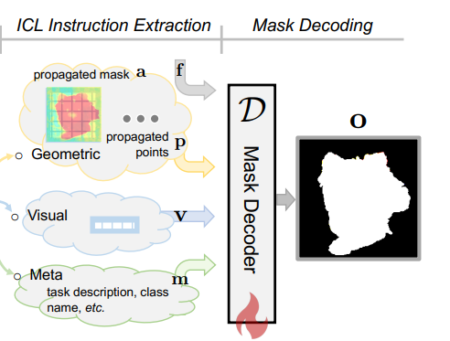
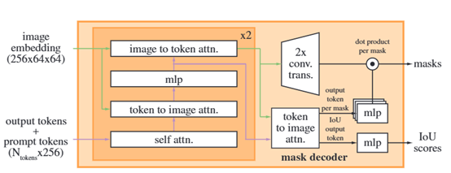
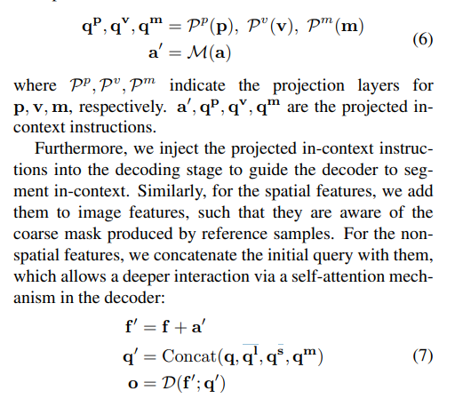
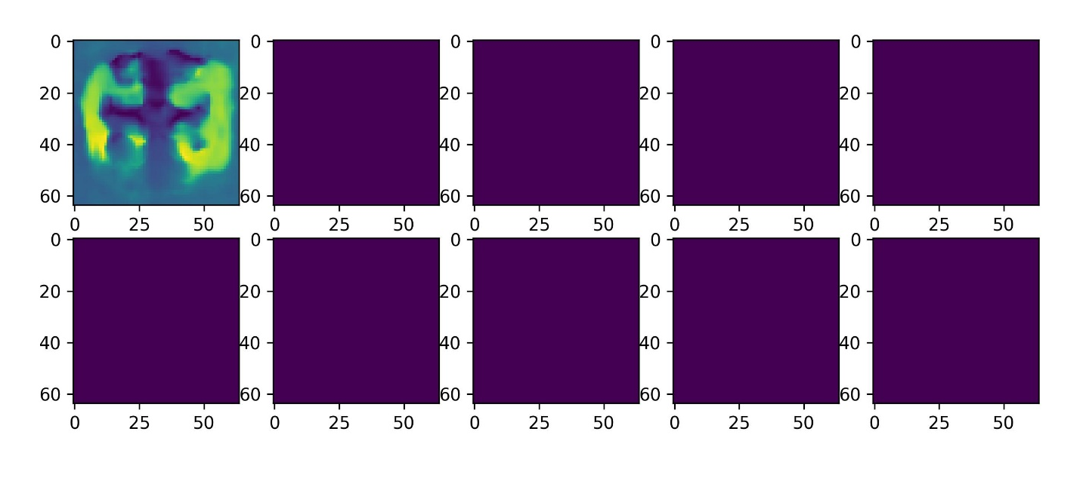
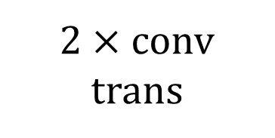
Image feature
Augmented Image Embeddings
Image to token attn
2 $×$ conv trans
Coarse mask
conv
mlp
Token to image attn
Token to image attn
Output tokens
Self attn

Slide 8
Dino + LORA + SAM decoder + cross attention | Out_dir_sam (acdc, stare, scd, wbc, spine) + pandental : no
Dino + LORA + Multi convs + cross attention | Out_dir_5 ( acdc, stare, scd, wbc)
Dino + LORA + Multi convs + simple fuse + single cross | Out_dir (delete, no)
Dino+ LORA+ SAM decoder + no cross + loss_weight | Pandental ok ，others very low
Dino + LORA + no cross + no trans | Best now
Dino + LORA + cross + trans + SAM decoder + loss change | Nan
Dino + LORA + no cross + trans

Slide 9
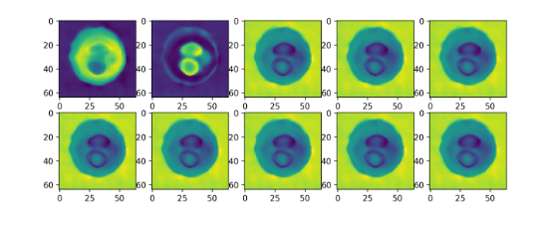
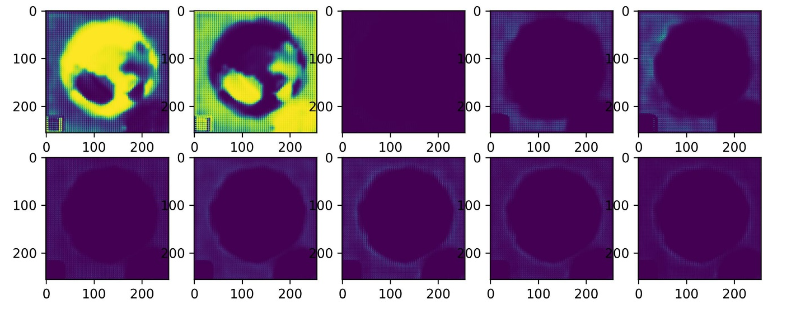
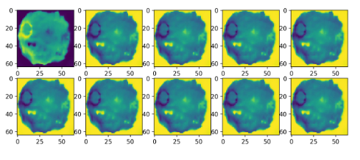
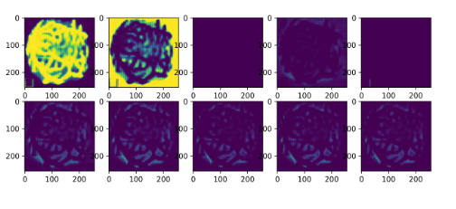
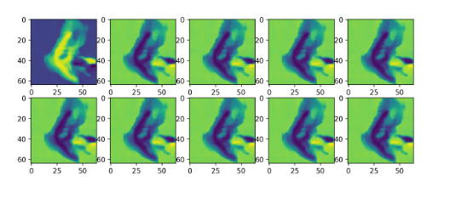
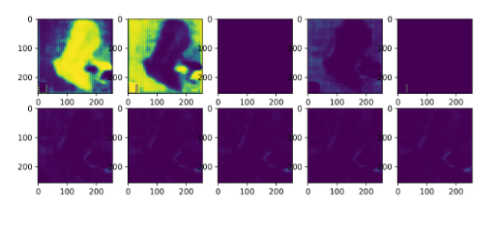

Slide 10
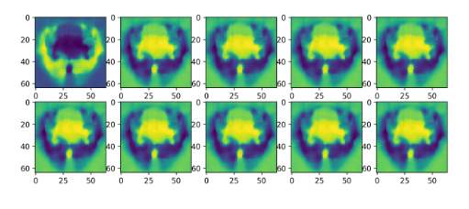
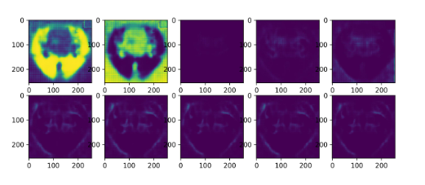
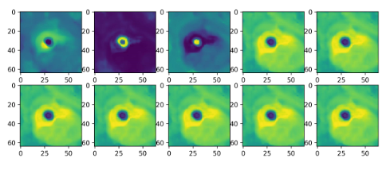
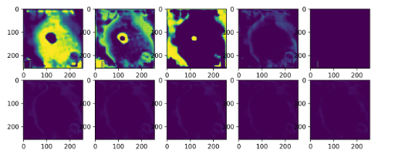
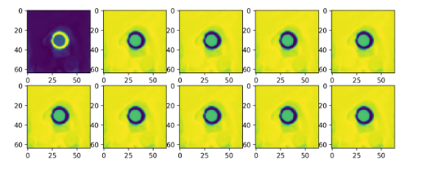
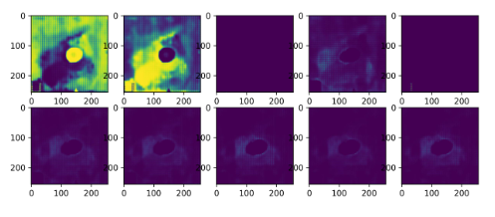

Slide 11
只计算前景的dice score
Methods | STARE | ACDC | SPINE | PANDENTAL | WBC | SCD
Universeg (64) | 48.1 | 70.9 | 64.6 | 87.5 | 90.6
Rerun (48) | 14.6 | 50.2 | 75.3 | 91.2 | 92.9 | 35.5
Rerun (32) | 14.6 | 53.7 | 73.1 | 87.5 | 92.3
Rerun (16) | 16.8 | 38.5 | 43.6 | 83.8 | 88.5
Thres > 0.5
Ours (16) | 44.0 | 55.6 | Thres > 0.001 | Thres > 0.001 62.7 | 70.0
Ours (32) | 43.9 | 68.1 |  | 68.4 | 75.1
Ours (48) | 43.8 | 79.3 | 27.3 | 59.7 | 71.6
channel-wise softmax
 | STARE | ACDC | SPINE | PANDENTAL | WBC | SCD
Ours (48) | 22.0 | 0.07 | 23.9 | 65.3 | 41.9
Ours+ SAM (48) | 34.8 | 67.9 | 46.5 | 14.0 | 74.5
 | 18.9 | 53.0 | 55.0 | 53.1 | 86.6 | 36.0

Slide 12
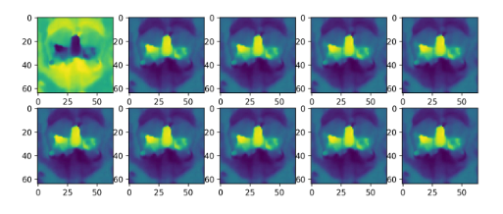
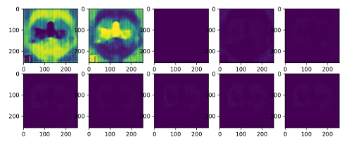
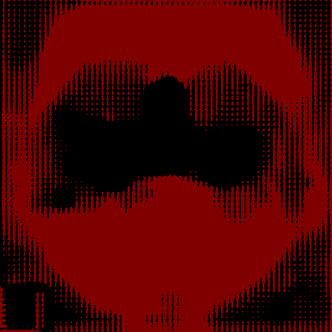


Slide 13
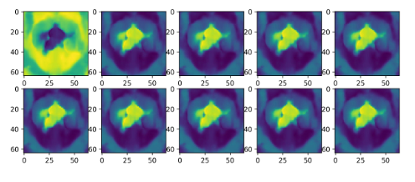
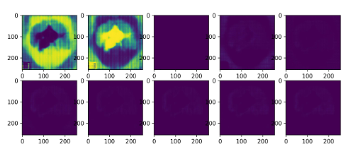
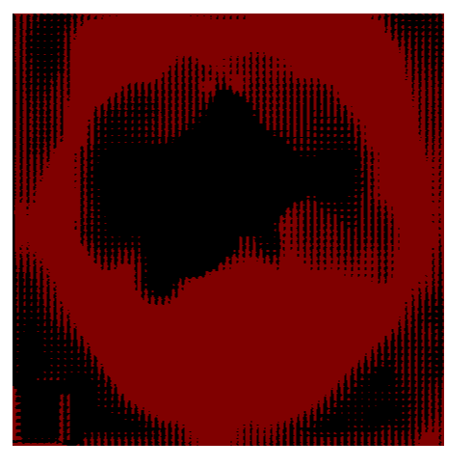
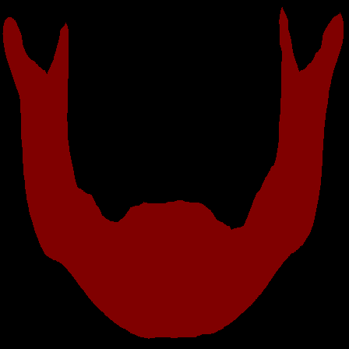

Slide 14
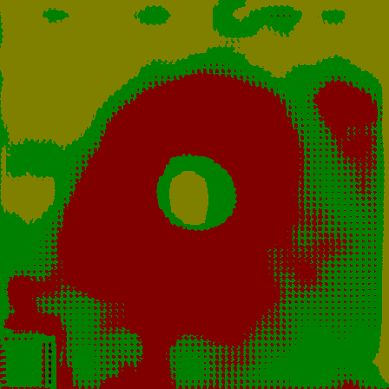
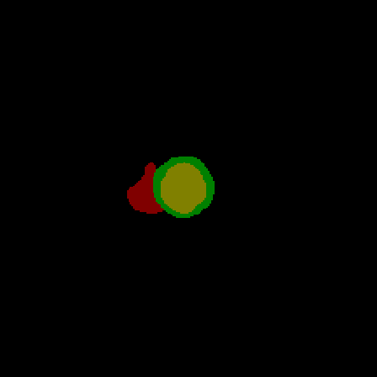
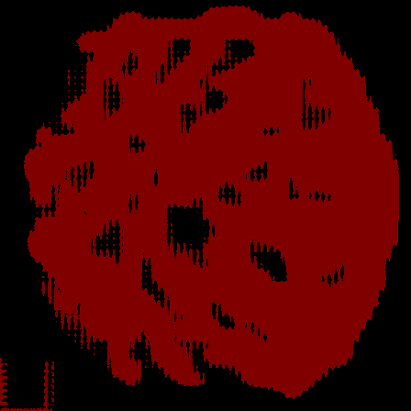
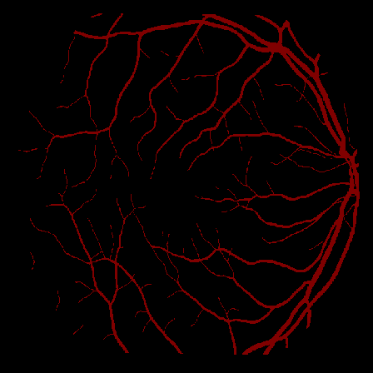

Slide 15
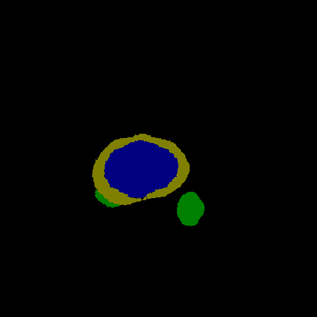
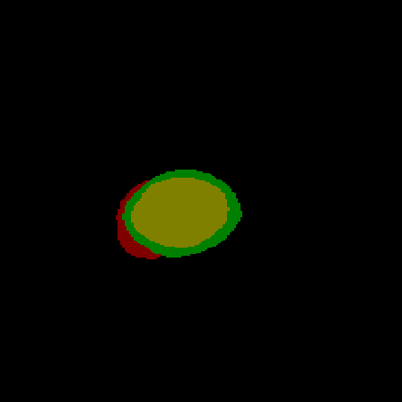
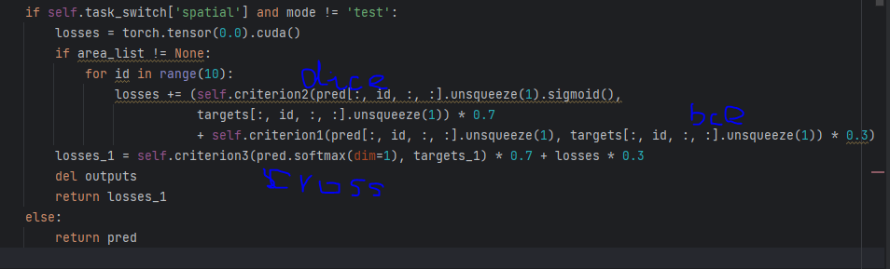

Slide 16
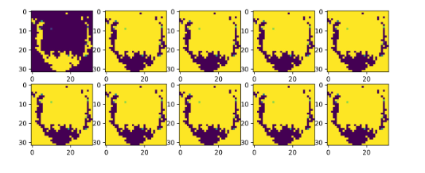





Slide 17



pred GT
pred GT
pred GT

Slide 18


Slide 19









Slide 20
蓝色列为训练集中没有出现的器官，黄色列为训练集中有的器官
Support_size = 30, repeat 5 times | ACDC | WBC | SCD | Spine | Pandental | STARE
Universeg | 64.58 | 90.76 | 40.22 | 64.84 | 84.37 | 16.88
Ours | 42.75 | 90.34 | 17.51 | 42.25 | 78.76 | 16.83
Support_size = 15, repeat 5 times | ACDC | WBC | SCD | Spine | Pandental | STARE
Universeg | 52.48 | 88.39 | 30.10 | 55.24 | 85.85 | 16.35
Ours | 38.48 | 89.71 | 19.87 | 41.04 | 81.04 | 16.45
Support_size = 5, repeat 5 times | ACDC | WBC | SCD | Spine | Pandental | STARE
Universeg | 34.75 | 84.29 | 32.48 | 46.07 | 76.60 | 17.22
Ours | 40.21 | 90.35 | 0.08 | 40.35 | 77.65 | 12.52

Slide 21
蓝色列为训练集中没有出现的器官，黄色列为训练集中有的器官
Support_size = 30, repeat 5 times | ACDC | WBC | SCD | Spine | Pandental | STARE
Universeg | 63.28
Ours | 51.86
Support_size = 15, repeat 5 times | ACDC | WBC | SCD | Spine | Pandental | STARE
Universeg | 53.21 | 89.87 | 36.57 | 63.21 | 88.76 | 16.63
Ours | 48.62 | 87.05 | 10.29 | 27.34 | 81.03 | 0.00007
Support_size = 5, repeat 5 times | ACDC | WBC | SCD | Spine | Pandental | STARE
Universeg | 46.27
Ours | 39.57

Slide 22
蓝色列为训练集中没有出现的器官，黄色列为训练集中有的器官
Support_size = 30, repeat 5 times | ACDC | WBC | SCD | Spine | Pandental | STARE
Universeg | 59.12 | 91.77 | 50.17 | 73.66 | 83.44 | 17.02
Ours | 41.91 | 87.26 | 43.15 | 40.47 | 78.87 | 32.85
Support_size = 15, repeat 5 times | ACDC | WBC | SCD | Spine | Pandental | STARE
Universeg | 48.73 | 89.89 | 43.70 | 66.96 | 85.57 | 16.11
Ours | 49.16 | 86.15 | 37.75 | 43.37 | 78.00 | 32.69
Support_size = 5, repeat 5 times | ACDC | WBC | SCD | Spine | Pandental | STARE
Universeg | 32.56 | 82.14 | 30.08 | 47.87 | 79.45 | 16.97
Ours | 36.33 | 86.88 | 0.02 | 34.20 | 74.01 | 0.04

Slide 23



Query & Localization Network
Query
image
Support
image
Cross Masked Attention$×2$
Prompt Mask Pool
Dinov2
. . . . . .
P1
P3
Upsample+
Double Conv
cos
......
Stage 1
P2
Pn
Cross Masked Attention$×2$
Upsample+
Double Conv
cos
P1
P3
Stage 2
......
Decoder
P2
Pn
Cross Masked Attention$×2$
P1
P3
cos
......
Stage 3
P2
Pn

Slide 24





Multi-scale interaction & Decoder Network
$$T_{j}^{1}$$
Cascaded Upsampler
$$T_{j}^{2}$$
$$T_{j}^{3}$$
$$T_{j}^{cat}$$
$${\tilde{T}}_{j}^{cat}$$

Slide 25
Dino + lora + sam decoder + freeze
Dino + lora + medsam + no final fuse
SAM-image encoder
F
Fused Feature
DINO
Coarse masks
Lora Finetune

Slide 26
Support=64 | ACDC | SCD | WBC | SPINE | STARE | PANDENTAL
Universeg | 65.19 | 52.95 | 91.43 | 76.60 | 42.00 | 84.07
Ours | 59.17 | 48.93 | 85.56 | 59.32 | 26.97 | 74.84
Support=64 | ACDC | SCD | WBC | SPINE | STARE | PANDENTAL
Universeg | 63.35 | 61.33 | 90.29 | 72.46 | 41.51 | 88.75
Ours | 64.96 | 51.39 | 89.46 | 55.71 | 30.72 | 81.39
Support=64 | ACDC | SCD | WBC | SPINE | STARE | PANDENTAL
Universeg | 59.84 | 59.33 | 91.97 | 64.71 | 41.19 | 86.18
Ours | 65.20 | 51.09 | 91.26 | 59.21 | 37.30 | 80.62
Support=64 | ACDC | SCD | WBC | SPINE | STARE | PANDENTAL | Monuseg
Universeg | 65.52 | 68.51 | 91.13 | 75.32 | 41.52 | 85.48 | 27.37
Ours | 71.93 | 59.80 | 91.07 | 59.01 | 38.11 | 78.87 | 42.00
 |  | 58.06
 |  | 59.17

Slide 27












Feature Extraction
Correspondence Discovery
IC Instruction Extraction
Mask Decoding
S
Finer Image Embedding
M
Target Image I

SAM
f
Coarse mask
flatten
D
(HW, )
Training : Only single image-mask pair
flatten
Mask Decoder
Self-prompt generation
f_r
(C, )
…….
Inference : Multiple image-mask pairs
DINO
Visual Feature

…

(HW,)

Slide 28
Support=48 | ACDC | SPINE | WBC | STARE | PANDENTAL | SCD
Universeg | 55.32 | 71.00 | 91.03 | 40.41 | 86.61 | 64.31
Ours | 59.39 | 51.95 | 89.81 | 19.21 | 79.93 | 61.56
Support=48 | ACDC | SPINE | WBC | STARE | PANDENTAL | SCD
Universeg | 56.19 |  | 91.86 |  | 84.38 | 55.93
Ours-SAMED | 59.44 |  | 90.26 |  | 79.92 | 59.58
Support=48 | ACDC | SPINE | WBC | STARE | PANDENTAL | SCD
Universeg |  |  |  | 40.87
Ours-MEDSAM |  |  |  | 43.30

Slide 29
调整LORA 试一下rank=64
保证前面的参数不动，只调整SAM和DINO的融合结构
尝试一下cross-prompt部分

Slide 30





Slide 31
Scribbleprompt 特征直接作为输入
 | SCD | ACDC | SPINE | WBC | STARE | PANDENTAL | Monuseg
UNIVERSEG | 64.24 | 53.83 | 78.51 | 92.59 | ---- | 85.95 | 26.59
OURS | 59.93 | 62.84 | 66.04 | 91.67 | ---- | 80.97 | 61.14
Scribbleprompt 特征乘上dino特征
 | SCD | ACDC | SPINE | WBC | STARE | PANDENTAL | Monuseg
UNIVERSEG | 63.44 | 65.73 | 78.79 | 91.88 | 41.51 | 86.34 | 27.70
OURS | 50.53 | 68.56 | 59.33 | 90.35 | 61.07 | 74.37 | 68.35
 | SCD（2） | ACDC （4） | SPINE （2） | WBC （3） | STARE（2） | PANDENTAL（2） | Monuseg （2） | Cervix （5） | Hipxray （3）
UNIVERSEG | 61.84 | 62.86 | 82.12 | 89.83 | 40.07 | 80.92 | 26.16 | 86.39 | 91.96
OURS | 56.61 | 66.64 | 68.30 | 89.12 | 62.97 | 74.75 | 43.83 | 79.24 | 89.40

Slide 32
 | SCD | STARE | SPINE | Monuseg
 |  | 40.74 |  | 27.65
 |  | 44.76 |  | 45.77
 | 61.79 | 41.64 | 74.28 | 27.73
 | 58.48 | 29.25 | 58.11 | 44.56
Attention(dino) * fea_sam + fea_sam
Attention(fea) * dino + dino
Dino(64) + SAM
SCD | universeg | Ours_ot | Ours
24 | 47.93 | 52.45 (14) | 52.69
24 | 51.82 | 53.76 (18) | 53.47
PanDental | universeg | Ours_ot | Ours
30 | 90.14 | 79.77 (18) | 79.97
30 | 84.93 | 72.98 (1) | 75.68
30

Slide 33
SCD | universeg | Ours_ot | Ours
24 | 47.93 | 52.45 (14) | 52.69
24 | 51.82 | 53.76 (18) | 53.47
PanDental | universeg | Ours_ot | Ours
30 | 90.14 | 79.77 (18) | 79.97
30 | 84.93 | 72.98 (1) | 75.68
30 | 82.71 | 73.49 (24) | 73.99
Spine | universeg | Ours_ot | Ours
48 | 69.92 | 62.86 (24) | 62.62
WBC | universeg | Ours_ot | Ours
48 | 91.66 | 88.38 (24) | 88.52

Slide 34
Inference : Class-aware DPC algorithm + OPT Image Matching
Training: Dino+SAM fusion module + similarity correspondance + SAM decoder

Slide 35
Spatial attention(fea_sam)*dino + dino
 | SCD | ACDC | WBC | PANDENTAL | SPINE | STARE
universeg | 66.12
ours | 50.57
先验证一下random_k和opt的区别，然后看下聚类数量的影响
想办法保存一下最好的模型30个epoch的，改一下代码
Class-wise mask DPC的实现
写一下intro部分

Slide 36






(b) PerSAM
flatten
…
Generative Model (MAE)
Training Mode
(a) SegGPT
(b) PerSAM
(c) DiverSeg
Pretrained Model (SAM)
Mask
Generation
$$L_{reg}$$
flatten
$$f$$
Generative Model (MAE)
Repeat C times
(HW, )
flatten
Prompt Generation
$$f_{r}$$
Cosine Similarity
(HW,)
Transformations
Multi-class & Multi-prompt
Single-class & Multi-prompt
Multi-class & Multi-prompt

Slide 37
 | SCD（2） | ACDC （4） | SPINE （2） | WBC （3） | STARE（2） | PANDENTAL（2） | Monuseg （2） | Cervix （5） | Hipxray （3）
UNIVERSEG | 54.11 | 56.54 |  | 92.61 | 41.68 |  | 27.20 |  | 93.59
OURS | 52.63 | 59.62 |  | 90.01 | 51.73 |  | 56.81 |  | 88.06
1 | 4 | 8 | 16 | 32 | 64
25.83 | 61.41 | 66.12 | 73.90 | 82.27 | 86.20
46.71 | 61.36 | 66.38 | 67.00 | 70.43 | 72.29

Slide 38
Fusion Module | SAM | DINO | DSC | HD95
N | SAM | N
N | MEDSAM | N
N | SAMMED | N
N | scripple | N
N | scripple | 1 | z output_dir_scripple_dino8feasam
concat | scripple | 1
Multi | scripple | 1 | z output_dir_scripple_dino8multi
attention1 | scripple | 1
attention2 | scripple | 1
fourier | scripple | 1
cross prompt |  |  | x (nan)
Multi | dino-64 | 1 | output_dir_scripple_dino64mul
N | scripple | 1 | output_dir_scripple_dino8feasam_tar

Slide 39




































Prediction
Input Images
Synapse
Brain
WBC
SCD
Tooth/spine
Mobuseg
Task
Prompt
Test
Image
DiverSeg
Prediction
Ground
Truth

Slide 40

flatten
f
(HW, )
flatten
f_r
(HW,)
226, 226, 231
243, 213, 211
 | cervix | hipxray
output_dir_scripple_dino8feasam | 79.66 |
 | 68.37 |
output_dir_scripple_dino8feasam_tar | 82.85 | 79.23|
 | 73.54 |72.48|
output_dir_scripple_dino64mul
output_dir_scripple_dino8multi | 80.29
 | 71.76
ours | 76.31
 | 71.48

Slide 41

DINO
SAM

Slide 42


